Slide 1

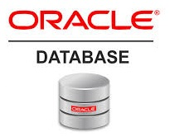
Oracle database
Lecture 2

Slide 2

Today’s Agenda
Introduction To SQL
Oracle V/s SQL
History Of SQL
What Is PL-SQL ?
How To Use SQL & PL-SQL ?
Types Of SQL Commands

Slide 3
Introduction To SQL
SQL is an abbreviation for “Structured Query Language”.
It is a language used by EVERY RDBMS to interact with the database.
It provides us COMMANDS for inserting data to a database, selecting data from the database and modifying data in the database

Slide 4
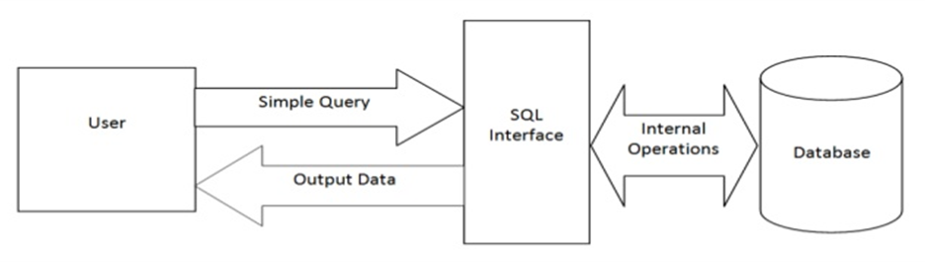
Pictorial View Of SQL

Slide 5
How SQL Is Pronounced ?
SQL is usually pronounced like the word “sequel”.
However, it’s a matter of preference (like gif vs. jif)—some people pronounce it in acronym form as all three letters.

Slide 6
Is SQL A Programming Lang ?
Yes, SQL is a language , but not exactly a programming language.
It’s not a language in the same sense as, Java or C++ or Python.

Slide 7
Is SQL A Programming Lang ?
SQL is a fourth-generation language, meaning commands are close to human language , which is mainly used to query the database
By contrast, the Java , C++ etc programming languages are third-generation languages that are more technical and are used to design the entire application for a specific requirement.

Slide 8
Who Created SQL ?
SQL was created by Donald Chamberlin and Raymond Boyce at IBM in the year 1974.
It’s original name was SEQUEL( Structured English Query Language).
In 1976 it was renamed to SQL.
Today it is the primary database language used in thousands of database applications.

Slide 9
Is SQL Case Sensitive?
No , SQL is not at all case sensitive for it’s command names or table names or data type name or function names.
However it becomes case sensitive when we match strings

Slide 10
Oracle Vs SQL ?
Oracle and SQL are two different things .
While Oracle is an OORDBMS , SQL is a special purpose language used to query the relational database.
As of 2020 , the standards of SQL are set by ANSI and each relational database has to provide their own SQL Engine which contains certain features of standard SQL and they may implement certain features in their own way.

Slide 11
What Is PL-SQL?
PL/SQL is a programming language developed by Oracle and it enables developers to combine the power of SQL with procedural statements.
It supports all the programming elements which are supported by any procedural programming language like variables , control statements , functions , procedures etc.

Slide 12
How To Use SQL/Pl-SQL In Oracle ?
Oracle provides us 2 tools to use write SQL queries and PL-SQL programs.
These tools are called:
SQL * Plus: It is a command line tool and we have to type in all the queries and programs to run them.
Oracle SQL Developer: It is an Integrated development environment (IDE) for working with SQL & PL-SQL in Oracle databases. The Oracle Corporation provides this product free; it uses the Java Development Kit.

Slide 13
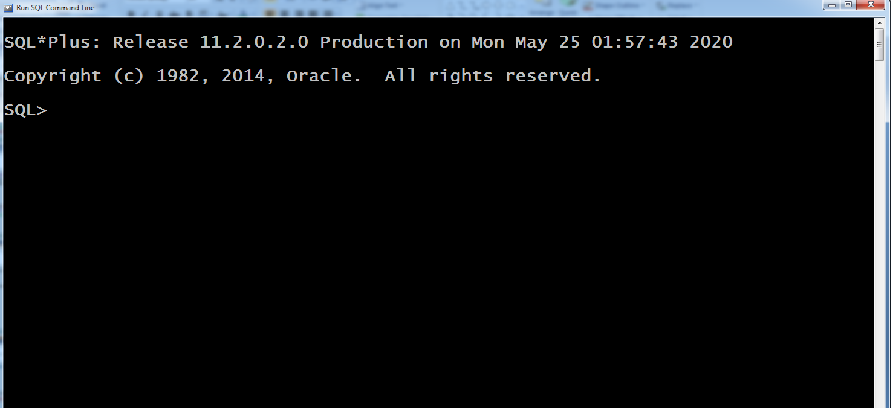
The SQL* Plus Tool

Slide 14
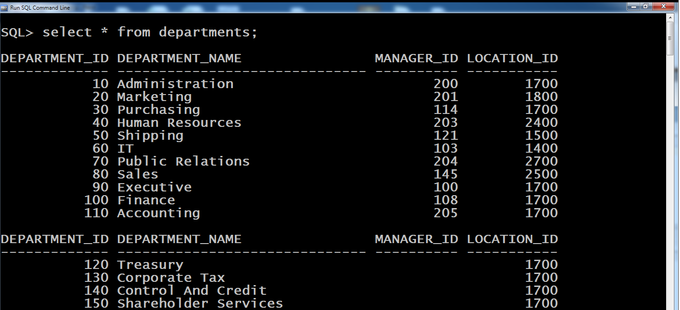
The SQL* Plus Tool

Slide 15
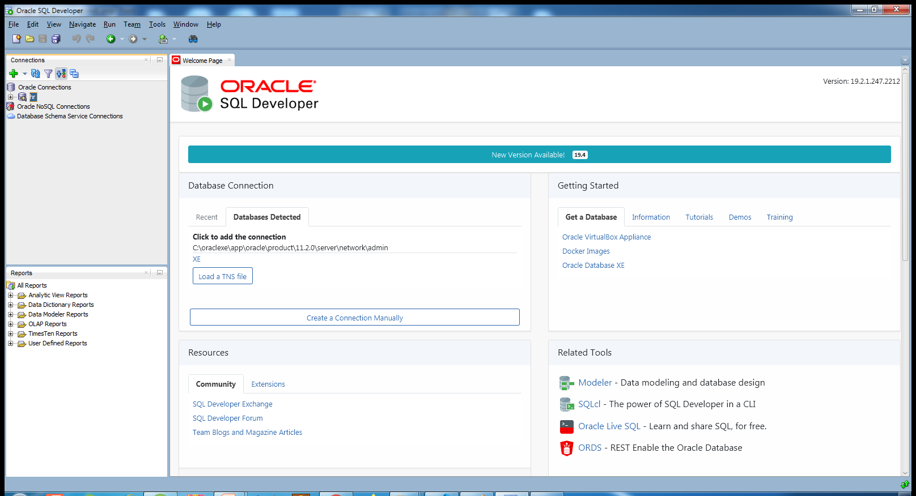
The SQL Developer Tool

Slide 16
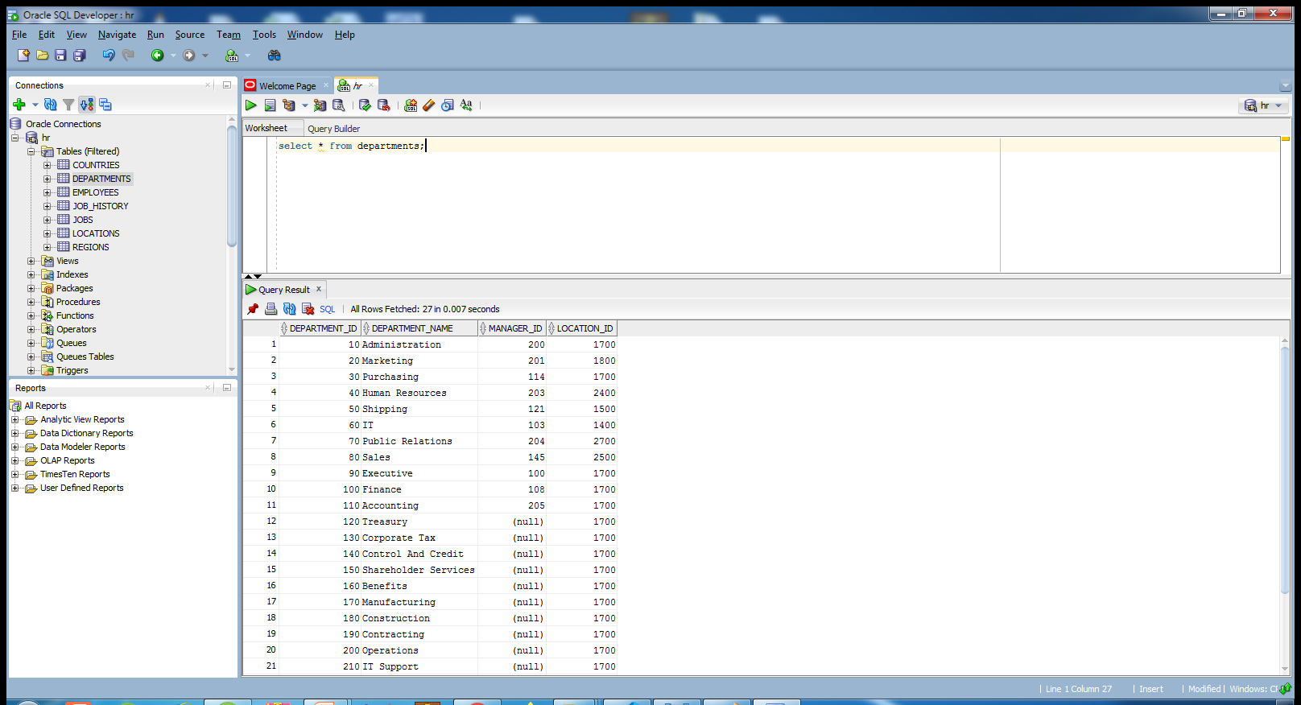
The SQL Developer Tool

Slide 17
SQL Commands
Learning SQL commands is the first step towards learning SQL.
Although there are many SQL commands but collectively they can be grouped in 5 categories and they are:
DDL : Data Definition Language
DML: Data Manipulation Language
DQL: Data Query Language
DCL: Data Control Language
TCL: Transaction Control Language

Slide 18
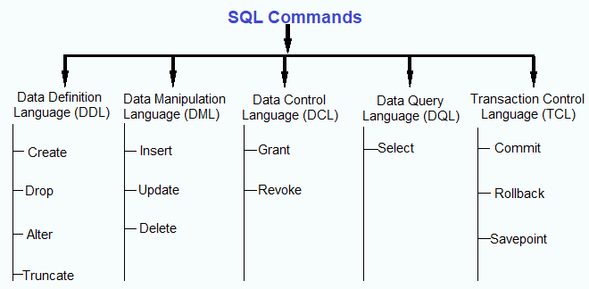
Categories Of SQL Commands

Slide 19
Data Definition Language
Data Definition Language or DDL commands are used for changing the structure of a table.
In other words, DDL commands are capable of creating, deleting, and modifying the structural information about the table.

Slide 20
Data Definition Language
These commands are:
CREATE TABLE
Used for creating a new table in the database
ALTER TABLE
Used altering structure of the table like adding /removing cols etc.
TRUNCATE TABLE
Used for deleting all rows from a table and free the space containing the table
DROP TABLE
Used for deleting an entire table from the database and all the data stored in it.

Slide 21
Data Manipulation Language
The DML or Data Manipulation Language commands help in modifying the contents of the table..
These commands are not auto-committed, which simply means that all changes made to the table using DML commands aren’t automatically saved.

Slide 22
Data Manipulation Language
These commands are:
INSERT
Used for inserting a new row in the table
UPDATE
Used to modifying the value of a column of a row in a table. It can update all rows or some selective rows
DELETE
Used for removing one or more rows from a table.

Slide 23
Data Query Language
The DQL command is used for fetching data from a relational database.
There is only one command in this category , which is the SELECT command.
SELECT command selects the attribute based on the condition described by the WHERE clause.

Slide 24
Data Control Language
In order to protect the information in a table from unauthorized access, the DCL commands are used.
A DCL command can either enable or disable a user from accessing information from a database.

Slide 25
Data Control Language
These commands are:
GRANT
Used for granting user access privileges to a table
REVOKE
Used for taking back permission given to a user.

Slide 26
Transaction Control Language
Transaction Control Language commands can only be used with DML commands.
TCL commands manage changes made by DML statements

Slide 27
Transaction Control Language
These commands are:
COMMIT
Used for saving all transactions made to a database.
ROLLBACK
Used to undo transactions that aren’t yet saved in the database.
SAVEPOINT
Used for rolling back to a certain state known as the savepoint.

